Slide 1

Research Progress Record
Enmao Diao
May 07, 2020

Slide 2
Overview
Multimodal controller for generative models
Experiment
Result
Next step

Slide 3
Multimodal controller for generative models
Example
N: batch size, D: input channel size, K: output channel size, C: the number of modes (classes)
Input X (NxD), Output Y (NxK), Weight W (DxK), mode indicator C (NxC) (one-hot vector).
MC (Multimodal Controller) has a codebook E (CxK)
The formulation of multimodal controlled linear layer
Y = XW
Ymc = Y * (CE) (*: element-wise multiplication)

Slide 4
Multimodal controller for generative models
Current baseline models
Variational generative models (Conditional VAE)
Stable results
Conditioning by concatenating trainable embeddings to the first layer of Encoder and Decoder
Autoregressive generative models (Conditional GatedPixelCNN)
Need fine tuning
Conditioning by adding trainable embeddings to GatedPixelCNN
Adversarial generative models (Conditional GAN)
Need fine tuning
Conditioning by concatenating trainable embeddings to the first layer of Generator and Discriminator

Slide 5
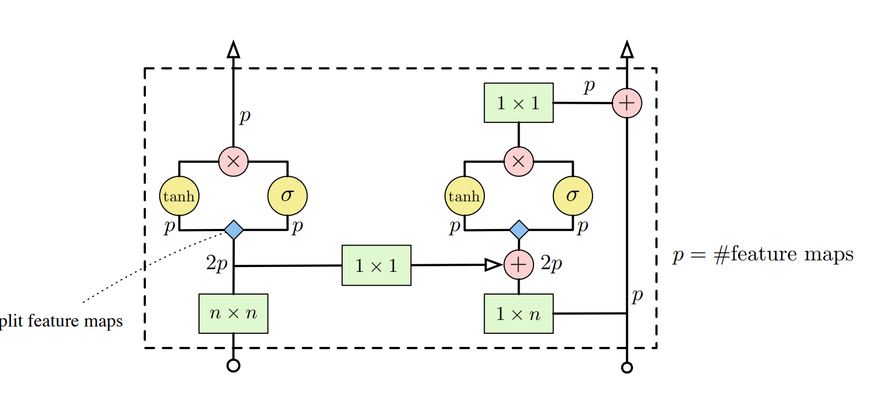
Multimodal controller for generative models
Autoregressive generative models (Conditional GatedPixelCNN) (https://arxiv.org/pdf/1606.05328.pdf)
Need fine tuning
Conditioning by adding trainable embeddings to GatedPixelCNN

Slide 6
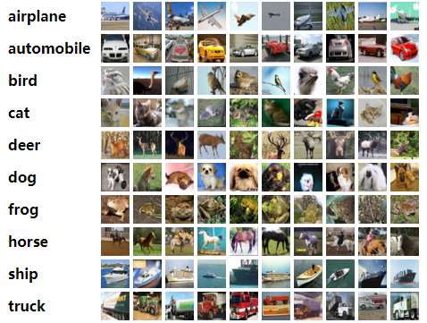
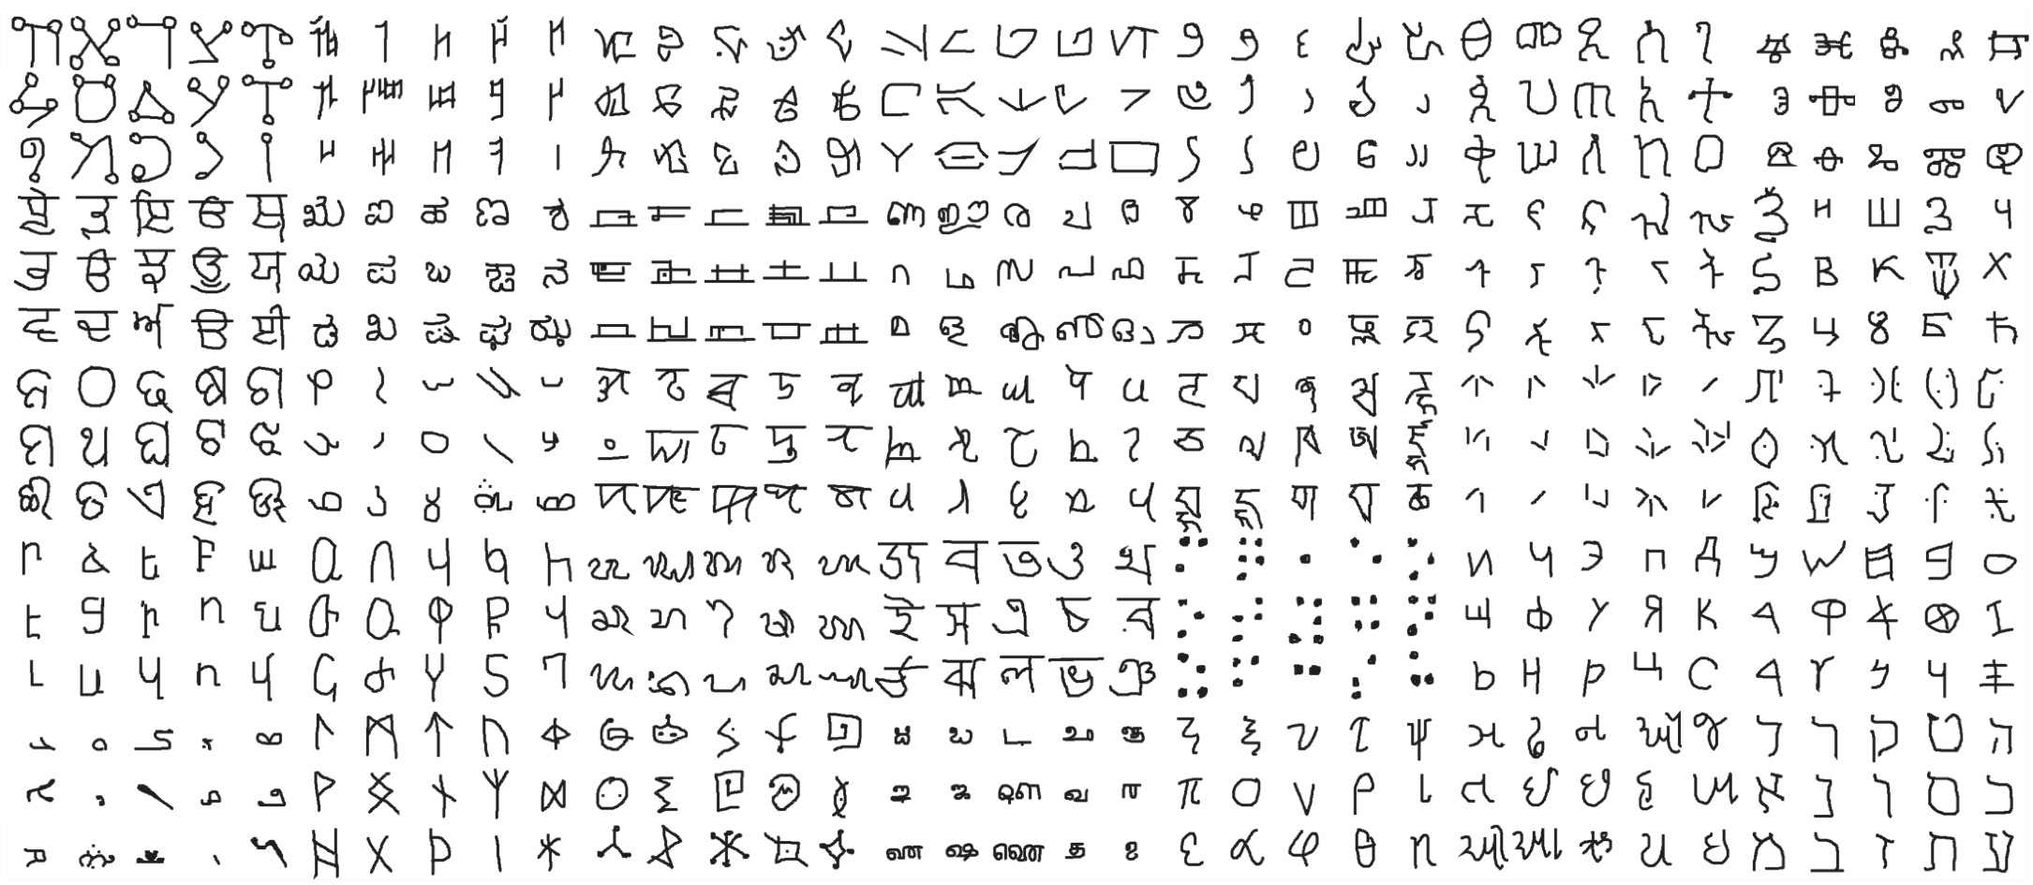
Multimodal controller for generative models
Experiments
Omniglot dataset (https://github.com/brendenlake/omniglot)
CIFAR10 dataset

Slide 7
Multimodal controller for generative models
Quantitative Result
CIFAR10
Model | Inception Score
MCVAE | 3.24
CVAE | 3.43
MCPixelCNN | 4.70
CPixelCNN | 4.88
MCGAN | 5.1
CGAN | 7.36

Slide 8
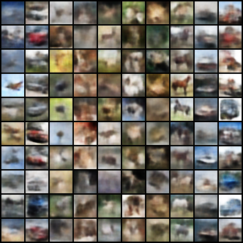
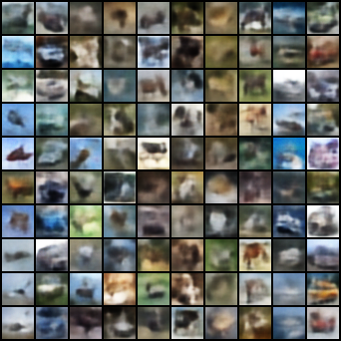
Multimodal controller for generative models
Qualitative Result
CIFAR10
MCVAE CVAE

Slide 9
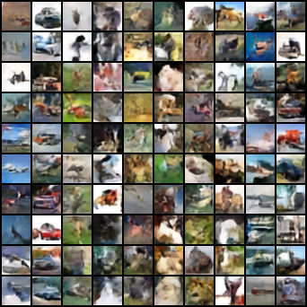
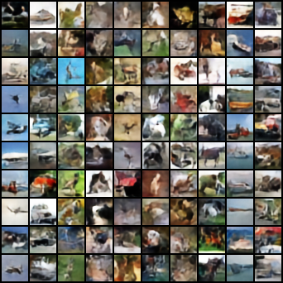
Multimodal controller for generative models
Qualitative Result
CIFAR10
MCPixelCNN CPixelCNN

Slide 10
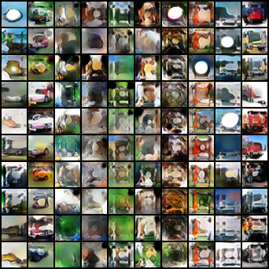
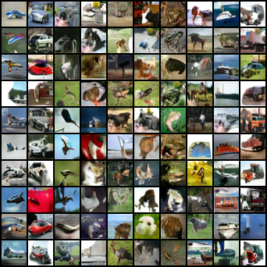
Multimodal controller for generative models
Qualitative Result
CIFAR10
MCGAN CGAN

Slide 11
Multimodal controller for generative models
Quantitative Result
Omniglot
Model | Inception Score
MCVAE | 597
CVAE | 160
MCPixelCNN | 450
CPixelCNN | 528
MCGAN | 456
CGAN | 280

Slide 12
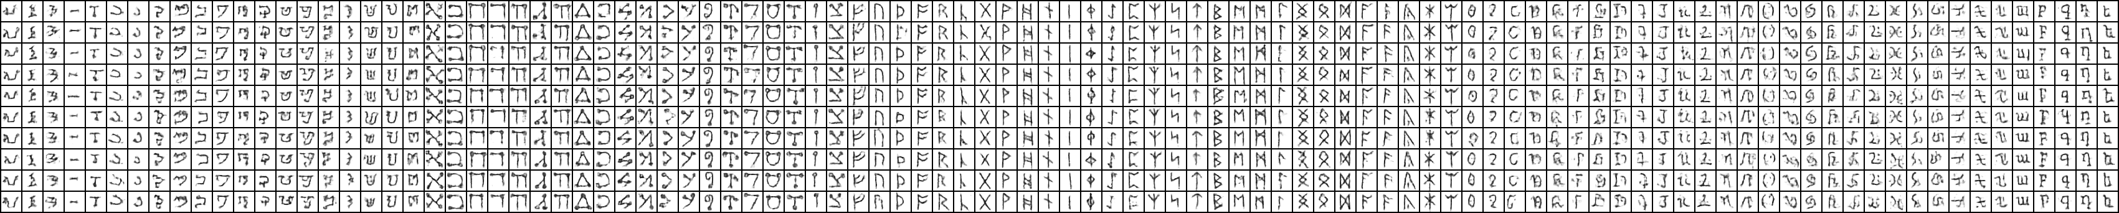
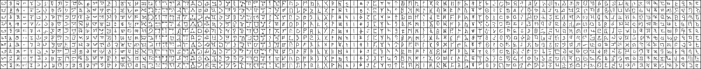
Multimodal controller for generative models
Qualitative Result
CIFAR10
MCVAE
CVAE

Slide 13
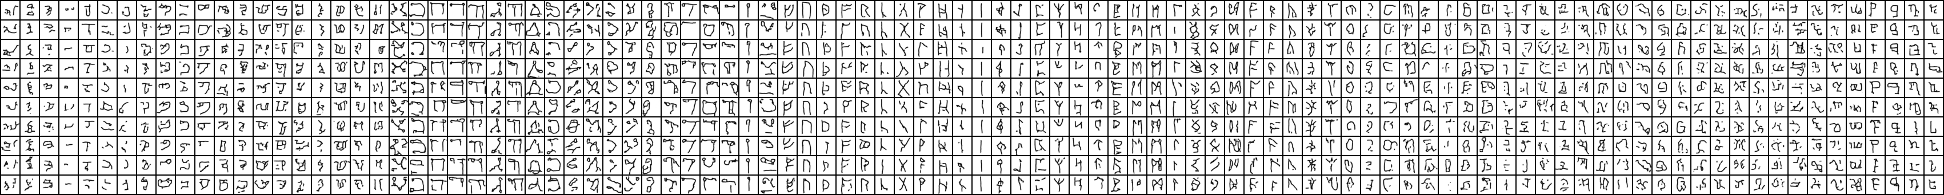
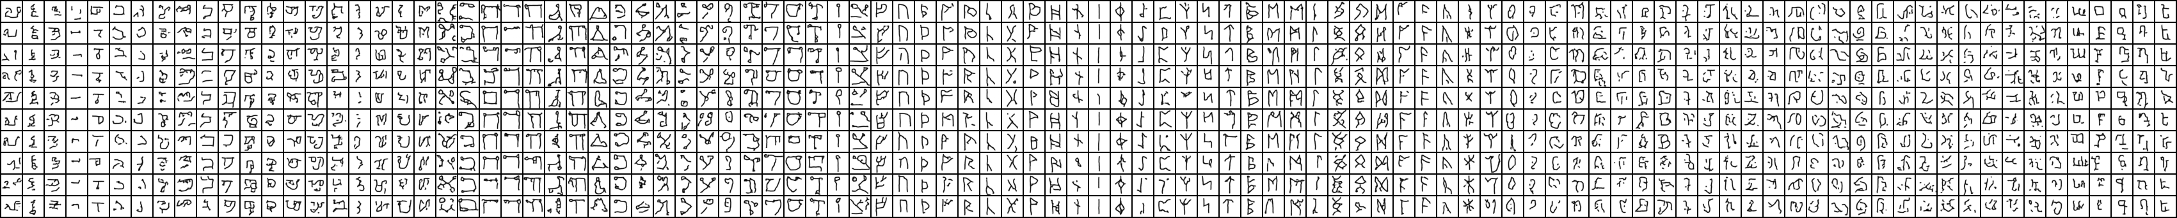
Multimodal controller for generative models
Qualitative Result
CIFAR10
MCPixelCNN
CPixelCNN

Slide 14
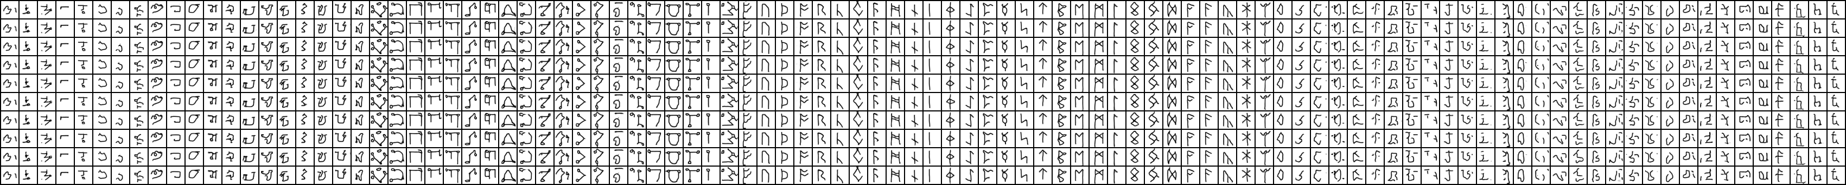
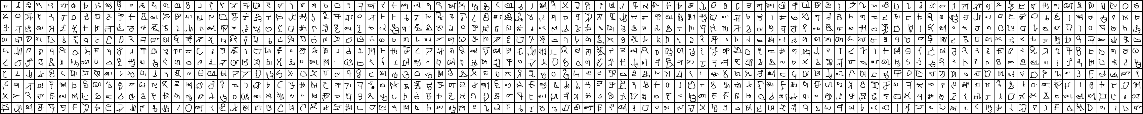
Multimodal controller for generative models
Qualitative Result
CIFAR10
MCGAN
CGAN

Slide 15
Multimodal controller for generative models
Discussion
VAE works fine
PixelCNN block is not a simple module to work with MC, need a little bit tuning on it
GAN degenerates with Spectral Normalization. We may need to use weaker discriminator, or not MC discriminator or switch back to MLP GAN

Slide 16
Multimodal controller for generative models
Create new model by changing embeddings for conditional models and multimodal controlled models
For conditional models we use convex combinations to create new embeddings E (CxD)
We set a Dirichlet distribution of size C with equal concentration by default. Then sample C times to get a CxC matrix K where each row sums to 1. The new embedding E’ = KE
For multimodal controlled models, we just randomly generate a new set of codebook. I think we may use method in genetic algorithm to create new codes which are the children of the codebook used in the trained network.

Slide 17
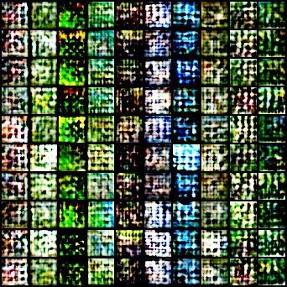
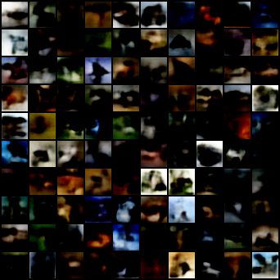
Multimodal controller for generative models
Qualitative Result
CIFAR10
MCVAE CVAE

Slide 18
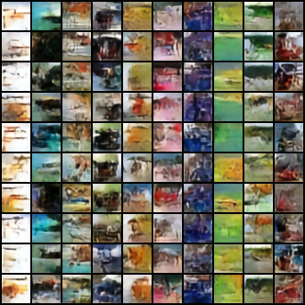
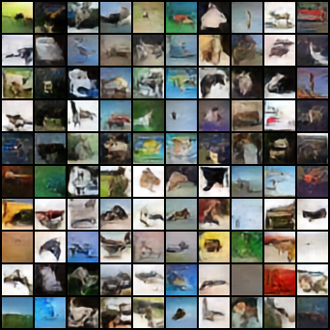
Multimodal controller for generative models
Qualitative Result
CIFAR10
MCPixelCNN CPixelCNN

Slide 19
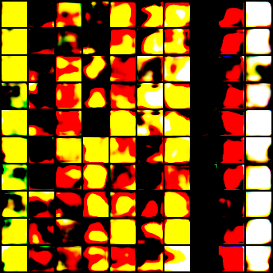
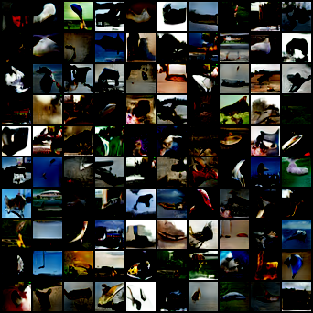
Multimodal controller for generative models
Qualitative Result
CIFAR10
MCGAN CGAN

Slide 20
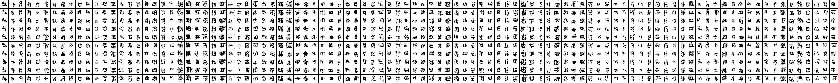
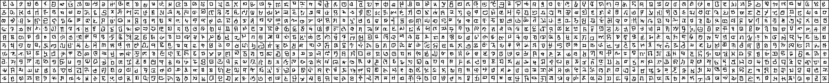
Multimodal controller for generative models
Qualitative Result
CIFAR10
MCVAE
CVAE

Slide 21
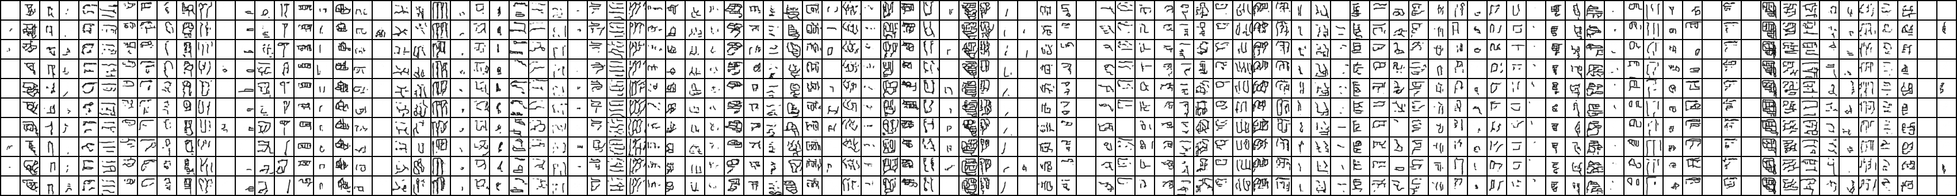
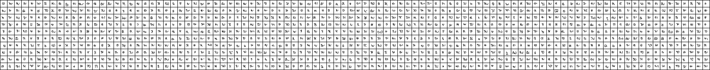
Multimodal controller for generative models
Qualitative Result
CIFAR10
MCPixelCNN
CPixelCNN

Slide 22
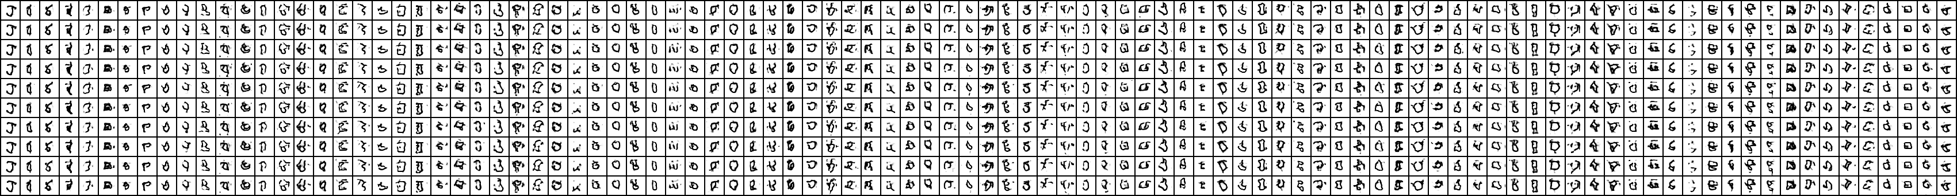
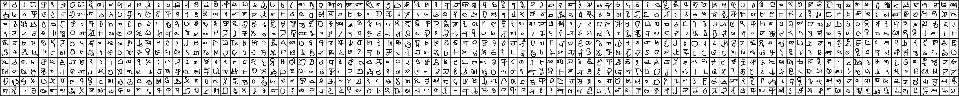
Multimodal controller for generative models
Qualitative Result
CIFAR10
MCGAN
CGAN

Slide 23
Multimodal controller for generative models
Discussion
Convex combination does not work with conditional generative models
For MC generative models trained with small classes size, randomly sampled codebook does not work either
We find randomly sampled codebook for dataset with large classes size promising.

Slide 24
Multimodal controller for generative models
Next Step
Urgent
Finalize PixelCNN. I don’t think MC version will bet condtitional ones because it actually has trained embeddings for every layer
Fine tune GAN and make it work
Create new codebook by using genetic method like mutation and crossover
Image Translation for VAE and GAN
Easy for conditional embeddings by interpolating two vectors with a step size
Not clear for MC models, we may match two codes one bit at a time to get closer to another but the transition may not be smooth
Use ImageNet 64x64 dataset
MC Normalization Flow

